Slide 1
MIPS
SIMULATOR CS3339 - DeAndre Johnson

Slide 2
Goals of this Project
Implement a faithful 5-stage MIPS pipeline (IF, ID, EX, MEM, WB)
Support a specific instruction set:
ADD, ADDI, SUB, MUL, AND, OR, SLL, SRL, LW, SW, BEQ, J, NOP
Decode instructions from assembly text
Maintain register file + memory
Print final results
Provide debug mode showing:
Pipeline registers
Control signals
Register file each cycle

Slide 3

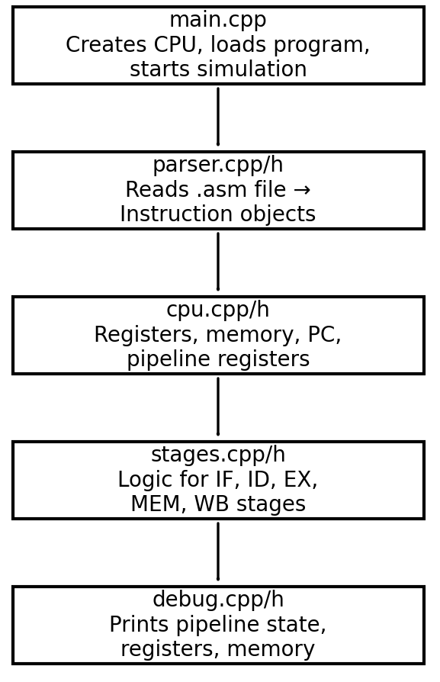
main.cpp • Program entry point • Reads the .asm file • Creates the CPU object • Starts the simulation loop
parser.cpp / parser.h • Reads the assembly file • Converts raw text into structured Instruction objects • Resolves labels for branches and jumps
cpu.cpp / cpu.h • Holds the CPU state: – Register file – Memory – Program Counter (PC) – Pipeline registers (IF/ID, ID/EX, EX/MEM, MEM/WB) • Runs the pipeline each cycle • Manages branching, flushing, and advancing stages
Overview with Diagram
stages.cpp / stages.h • Implements logic for each pipeline stage: – IF: Instruction Fetch – ID: Instruction Decode & register read – EX: ALU operation & branch decision – MEM: Memory load/store – WB: Write results back to registers
debug.cpp / debug.h • Prints pipeline state each cycle in debug mode • Prints final register file and memory contents

Slide 4
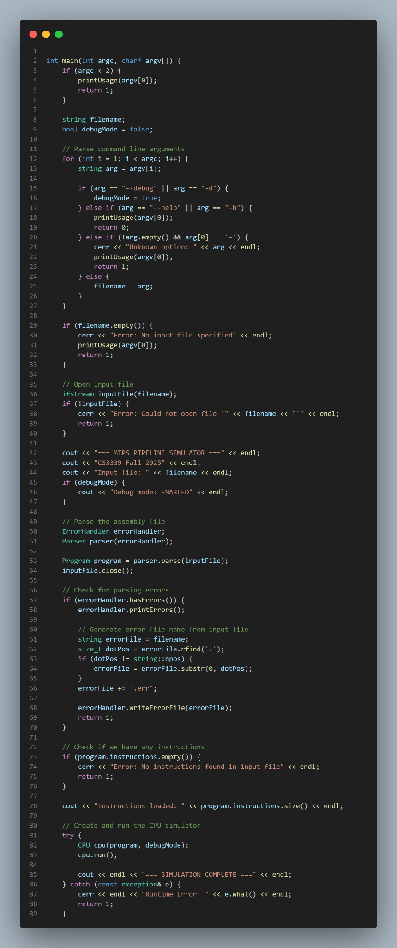
How the Simulator Executes
1. We begin by running main.cpp.
This is the entry point of the entire program.
It reads the .asm file we pass on in the command line.
It then creates a CPU object and hands the loaded instructions to it.
Finally, it calls cpu.run() to start the simulation.
int main(int argc, char* argv[]) {
if (argc < 2) {
printUsage(argv[0]);
return 1;
}
// Open input file
ifstream inputFile(filename);
if (!inputFile) {
cerr << "Error: Could not open file '" << filename << "'" << endl;
return 1;
}

Slide 5
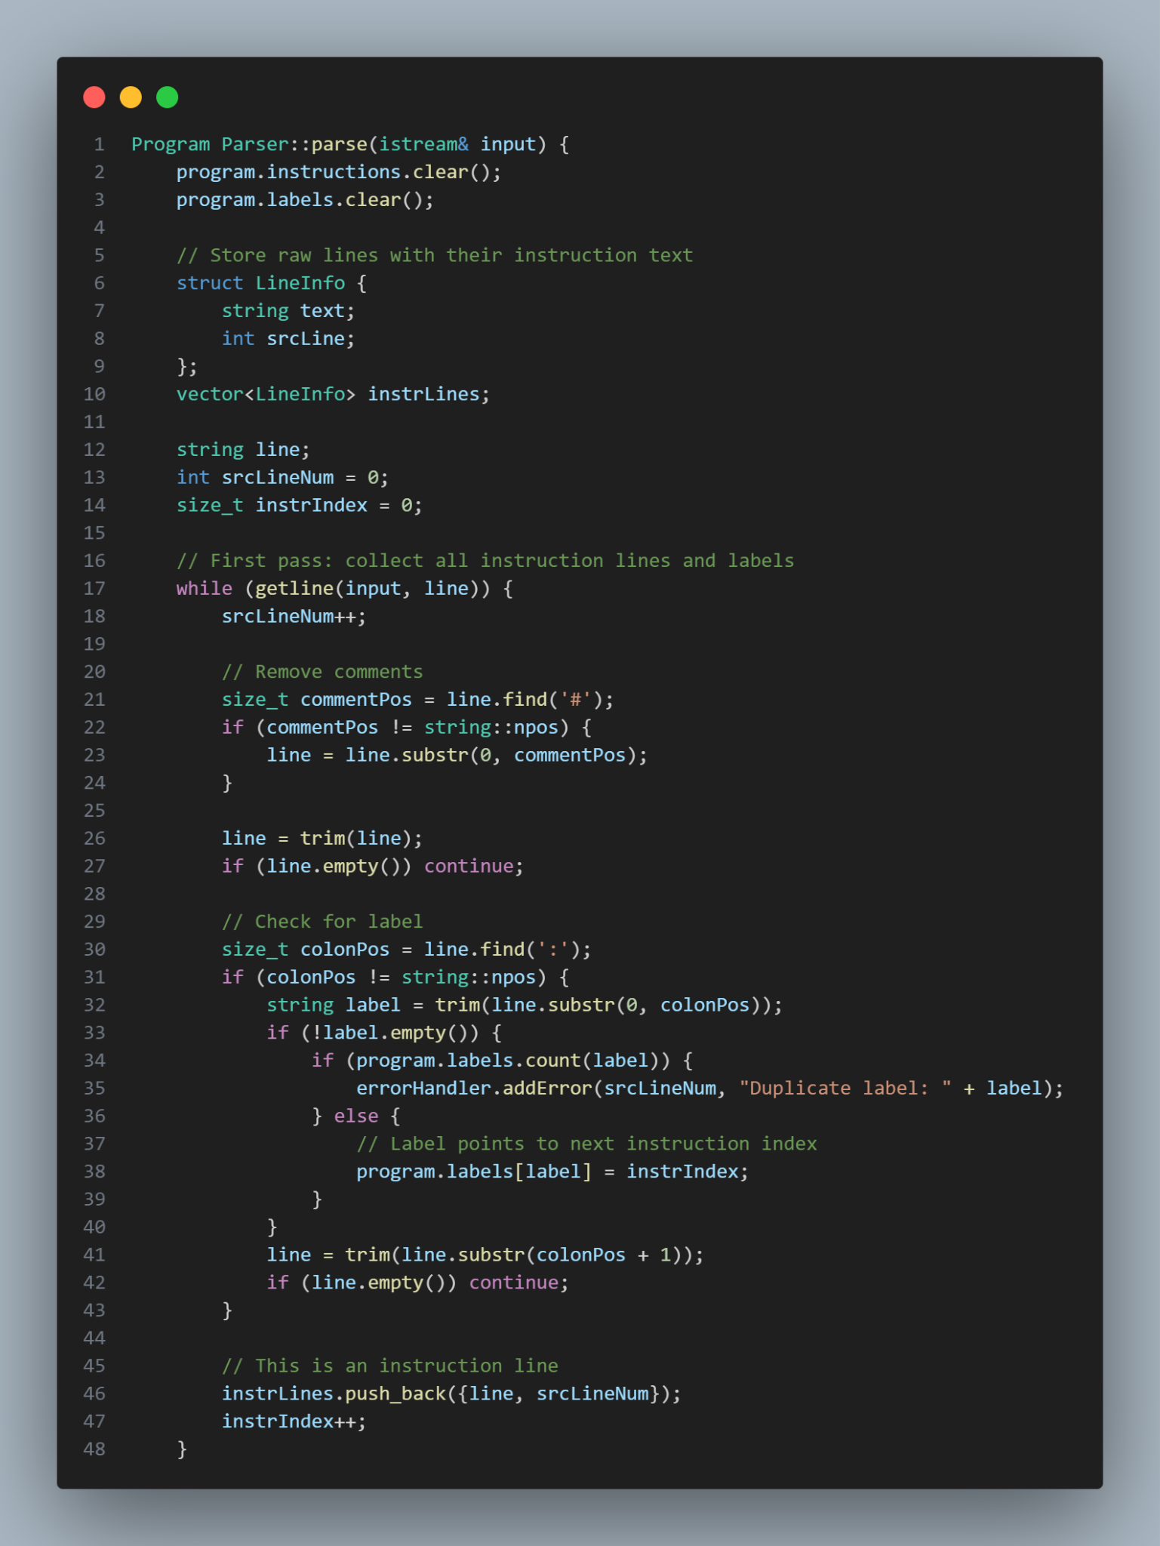
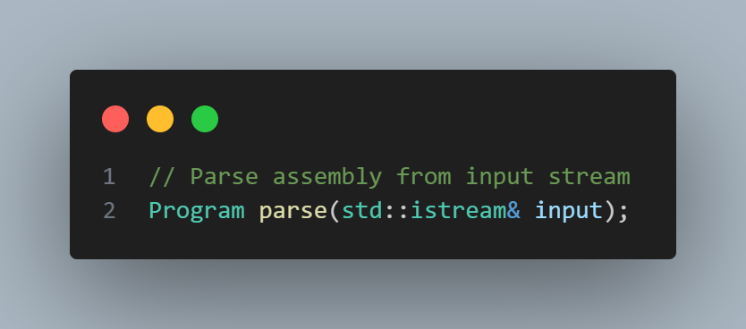
Parsing the Assembly
2. After main.cpp loads the file, it uses Parser::parse() from parser.cpp.
Reads the raw text of the .asm file
Detects labels (like loop:)
Converts each instruction line into a structured Instruction object
Resolves label targets for BEQ and J
Returns a vector of decoded instructions to the CPU
The CPU cannot just read plain text. The parser turns the text into the Instruction objects
the pipeline will execute. It also removes comments.

Slide 6
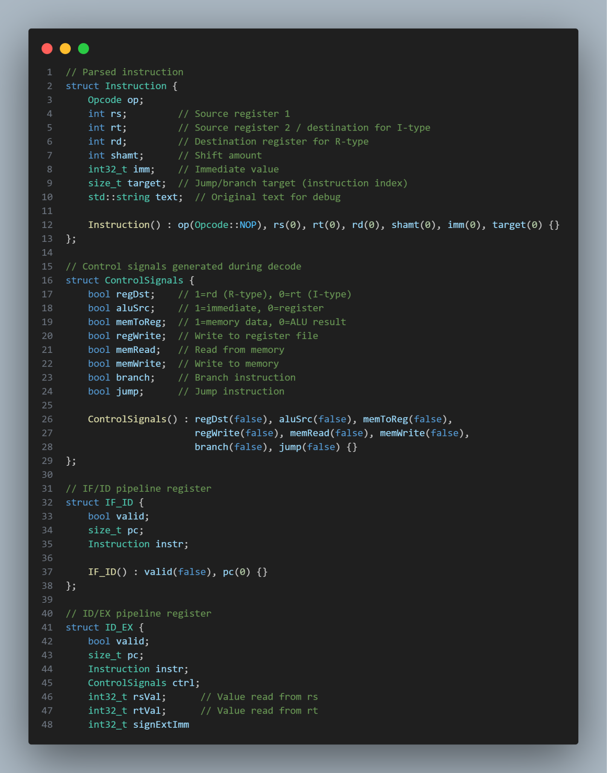
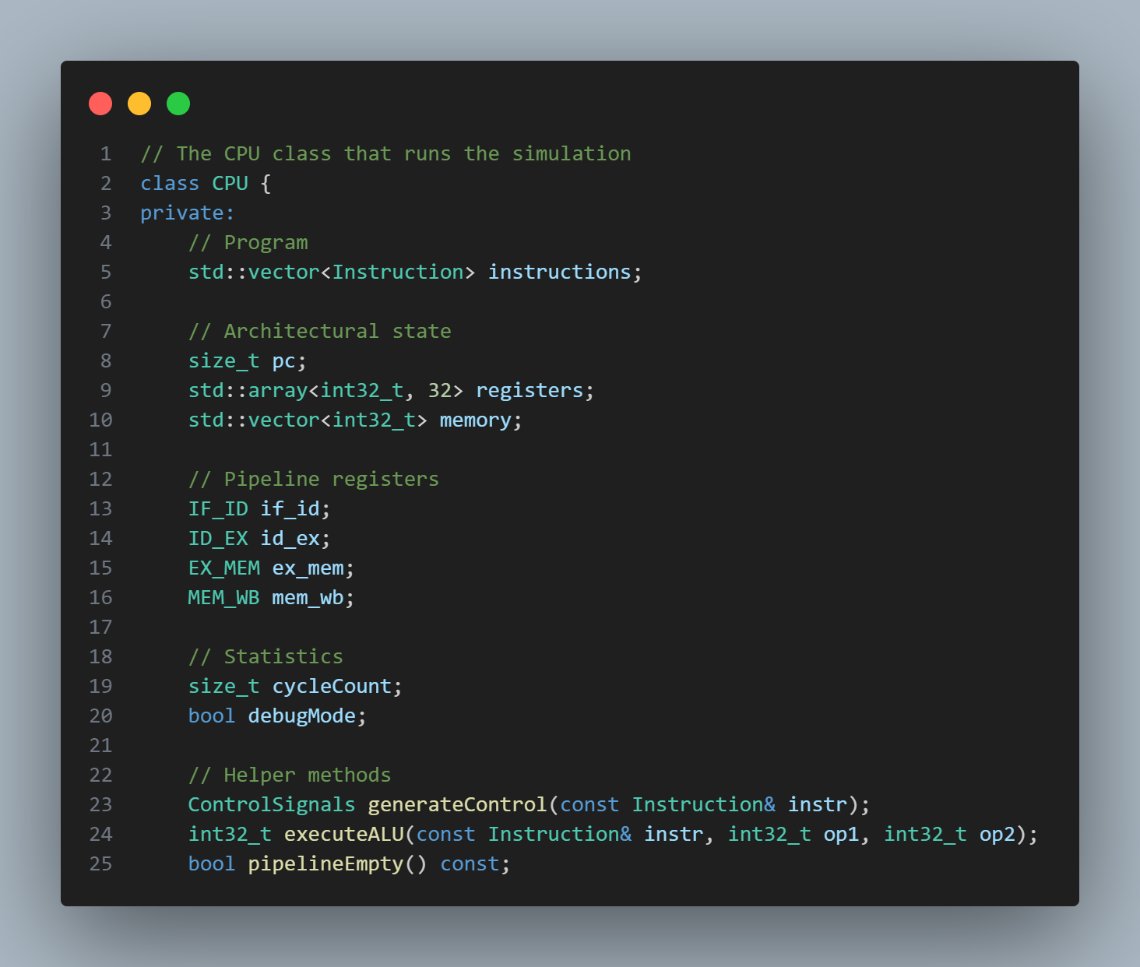
CPU Setup
3. When main.cpp calls cpu.run(), the CPU has now:
Created a register file of 32 registers
Created a block of memory
Set program counter (PC) to 0
Four pipeline registers:
IF/ID
ID/EX
EX/MEM
MEM/WB
This matches the structure of a real life 5-stage MIPS pipeline.
At this moment, the CPU is fully initialized and ready to begin the pipeline.

Slide 7
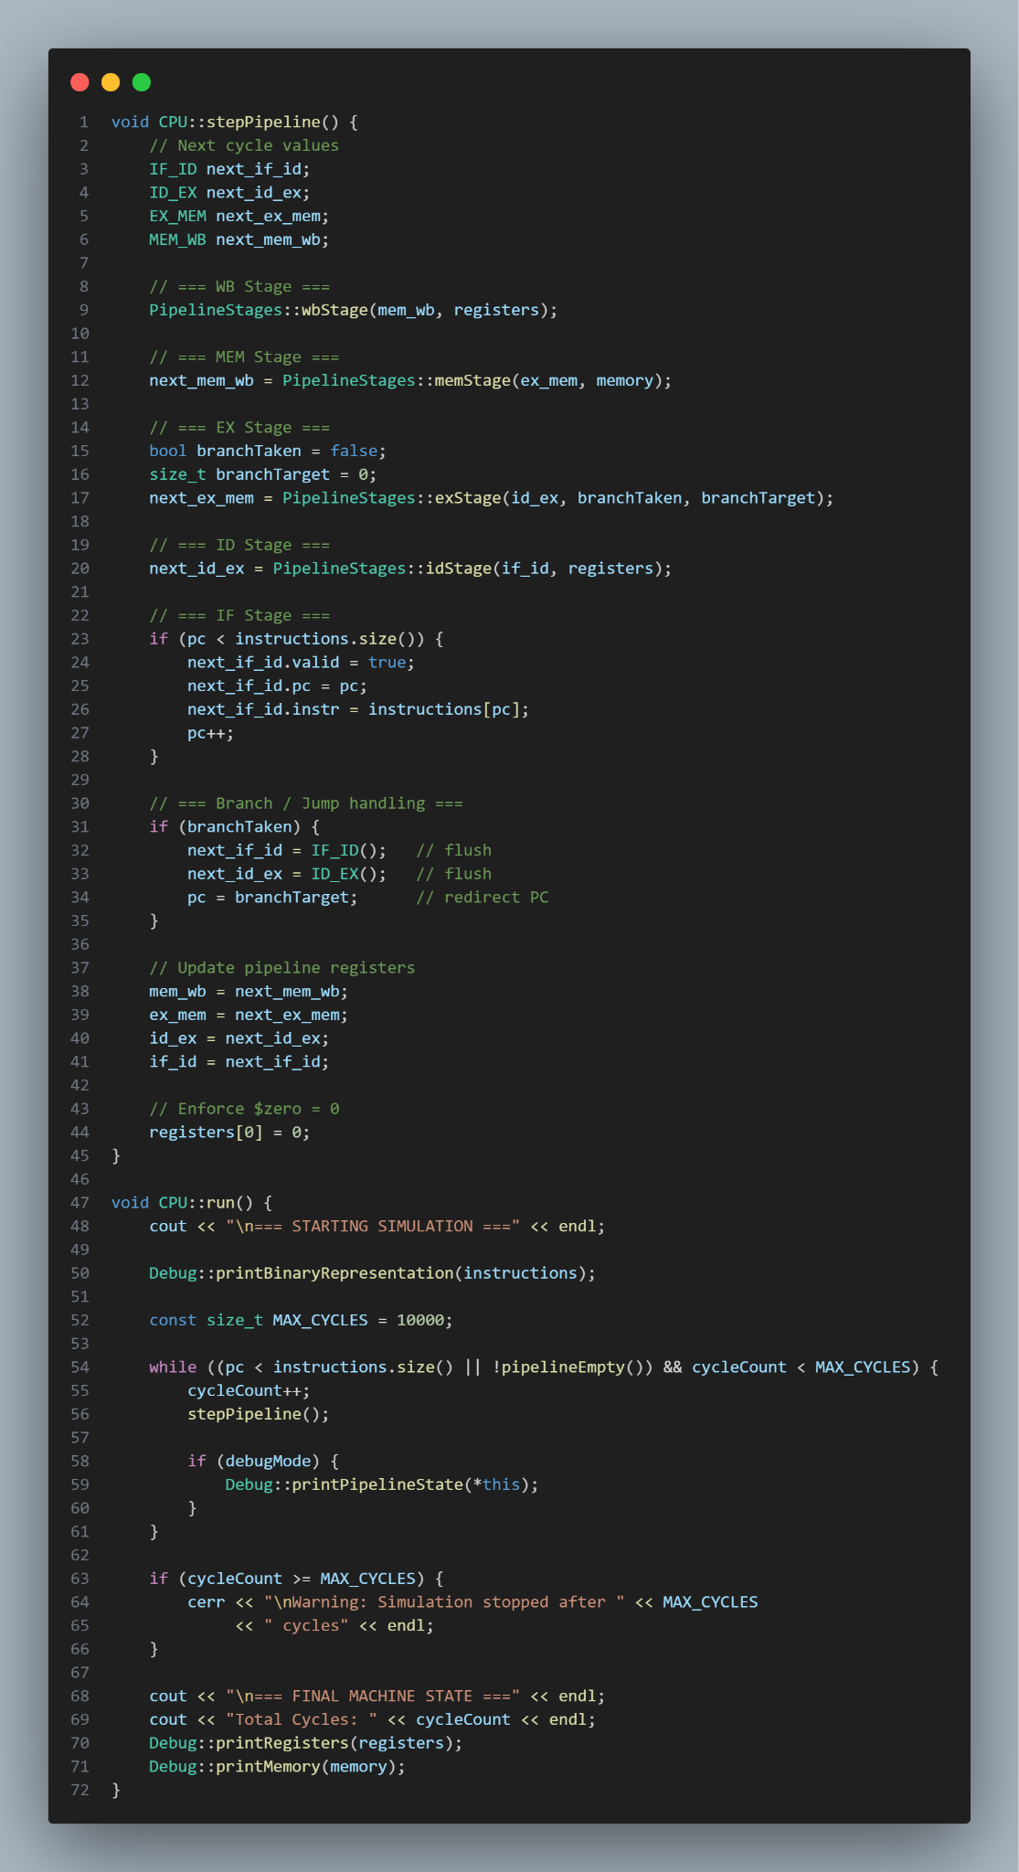
Pipeline Execution Begins
cpu.run() prints the instruction binary (optional) and then enters a loop:
Each cycle calls:
cpu.stepPipeline()
This advances all 5 pipeline stages.

Slide 8
STAGES
1. IF (Instruction Fetch)
Reads the next instruction using the PC
Places it into the IF/ID pipeline register
Updates PC for the next instruction
2. ID (Instruction Decode & Register Read)
Reads instruction from IF/ID
Extracts opcode, registers, immediate
Reads the register file (registers[rs], registers[rt])
Generates the control signals needed by later stages
Writes all of this into ID/EX
3. EX (Execute / ALU)
Performs arithmetic and logic: ADD, SUB, MUL, AND, OR, shifts
Calculates addresses for LW/SW
Evaluates BEQ (branch taken or not) and Handles J (jump)
Passes results to EX/MEM
If a branch/jump is taken, CPU flushes incorrect instructions and updates PC
4. MEM (Memory access)
LW (Load Word): fetch a 32-bit value from memory
SW (Store Word): save a 32-bit value into memory
Uses the address computed in EX
Writes result into MEM/WB
5. WB (Write Back)
If regWrite is set, the result is written to the destination register
If the instruction was LW, the value comes from memory
Otherwise, it comes from the ALU

Slide 9
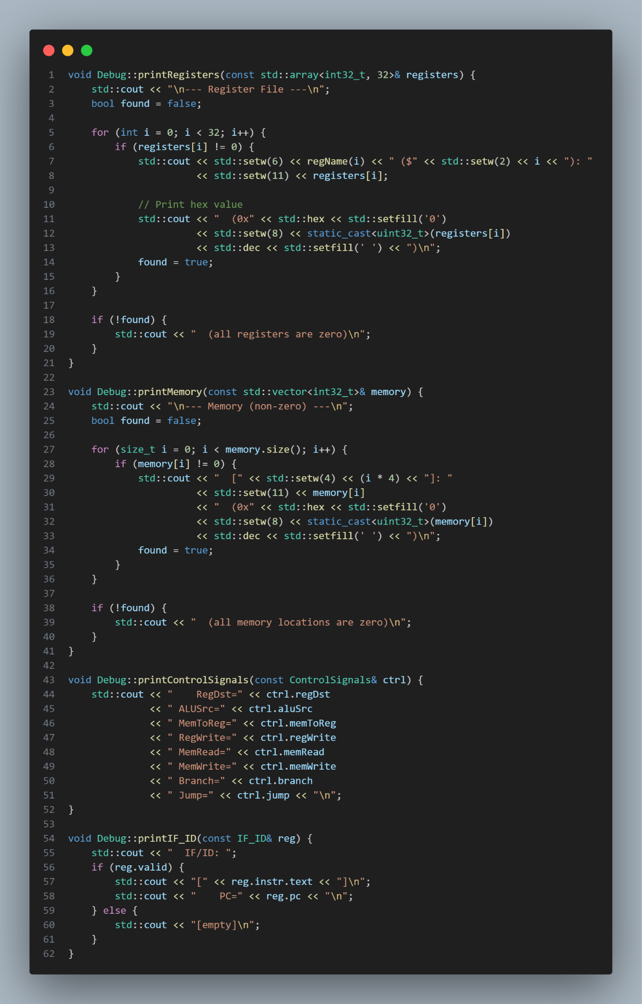
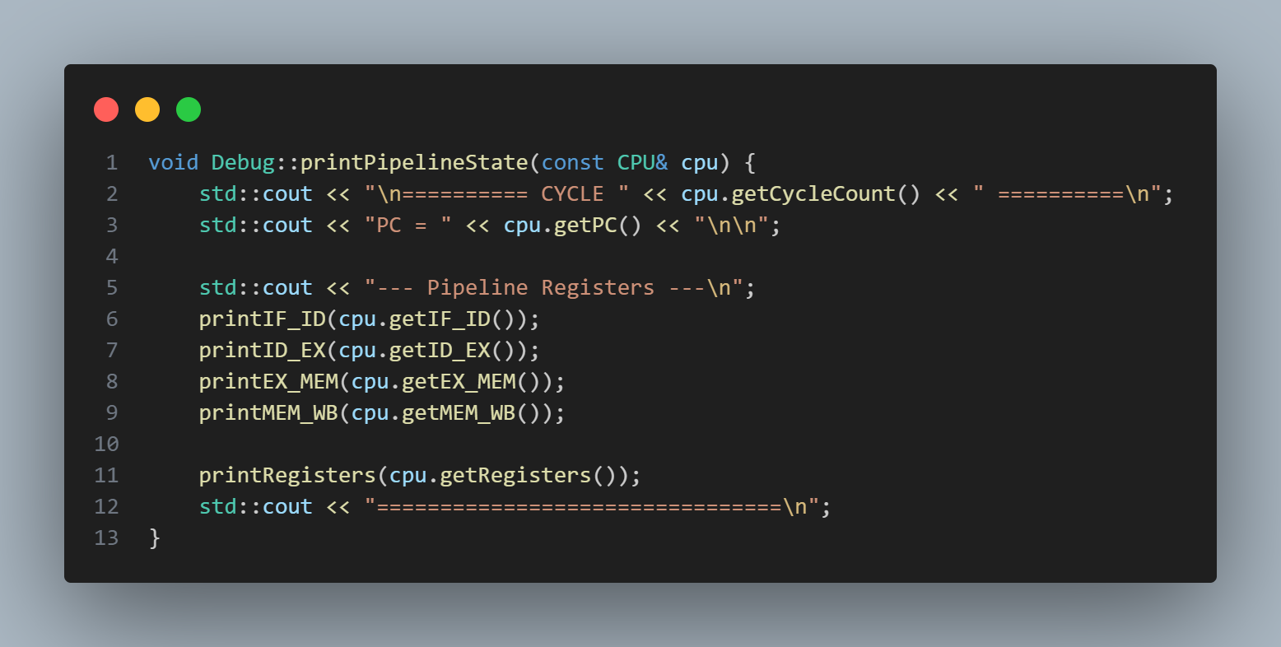
Debug Output
If --debug is used, each cycle prints:
Pipeline registers (IF/ID, ID/EX, EX/MEM, MEM/WB)
Register file
Control signals
PC value

Slide 10
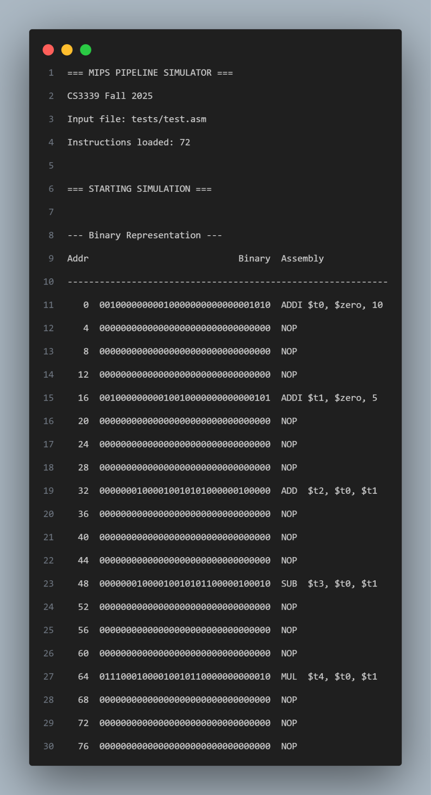
Finishing the Simulation
The loop in cpu.run() continues until:
PC moves past the last instruction
All pipeline registers become empty
Then:
Final register file is printed
Final memory contents are printed
Total cycle count is shown
This produces the results we see here:

Slide 11
Computer icon pack

